Slide 1

LOG ANALYSIS SYSTEM
2520030017 – G.VARSHINI
2520030430 – K.PRAGNYA
2520030482 – M.AVISHYA

Slide 2
ABSTRACT
The Log Analysis System is designed to identify recurring error patterns from massive server log files efficiently. The system analyzes continuous streams of log data and searches for predefined error signatures using efficient string-matching algorithms. It detects repeated errors and categorizes them based on their frequency and severity level. The system can handle large datasets without requiring administrators to manually inspect every log entry. It continuously monitors log files to identify new errors as they occur. The detected errors are organized into meaningful categories such as low, medium, and high severity.
Summary reports are generated to provide information about frequently occurring errors and their impact on the server. The system helps administrators identify recurring faults and understand their possible causes. Efficient searching techniques improve the speed of error detection and reduce processing time. The solution is designed to support large-scale log analysis and continuous monitoring. By automating the fault-detection process, the system reduces manual effort and improves troubleshooting efficiency. Overall, the proposed system assists system administrators in quick fault diagnosis, server monitoring, and maintaining system reliability.

Slide 3
INTRODUCTION
In modern computing environments, servers generate millions of log entries every day to record system activities, user requests, errors, and security events. Analyzing these large log files manually is time-consuming and may cause important errors to be missed.
A Log Analysis System provides an automated solution for processing and analyzing server logs. It searches the logs for predefined error patterns or signatures and identifies matching entries using efficient string-matching algorithms.

Slide 4
The system categorizes detected errors according to their frequency and severity, making it easier to identify the most critical and recurring problems. It also supports continuous log monitoring, allowing newly generated errors to be detected quickly.
The analyzed results are presented as matched logs and summary reports, helping system administrators understand server problems more effectively. By reducing manual effort and improving the speed of error detection, the system supports quick fault diagnosis, better server monitoring, and improved system reliability.

Slide 5
LITERATURE AND GROUNDING
Log Files
Large server log files containing system activities and events.
May include timestamps, IP addresses, user activities, warnings, and error messages.
Logs can be in formats such as .log, .txt, or other structured formats.
Predefined Error Patterns
A collection of known error messages or signatures that the system needs to search for.
Examples: Connection refused, File not found, Database error, Authentication failed.
These patterns help the system quickly identify known problems.
Severity Information
Error patterns can be associated with severity levels such as Low, Medium, High, and Critical.
This helps administrators prioritize important errors.
Monitoring Input
For continuous monitoring, newly generated log entries are continuously provided to the system.
The system analyzes new entries as they appear and detects matching error patterns.

Slide 6
Matched Logs are the log entries that contain one or more of the predefined error patterns or signatures.
The system provides:
Matched error message – the detected error from the log.
Timestamp – when the error occurred.
Error pattern/signature – the predefined pattern that matched.
Frequency – number of times the same error occurred.
Severity – Low, Medium, High, or Critical.
Source information – server, application, or service where the error occurred.
Summary report – a consolidated list of recurring errors and their frequencies.
Example:
2026-08-24 10:30:15 | Database Connection Failed | Frequency: 25 | Severity: High
This output helps system administrators quickly identify recurring and critical faults in the server.

Slide 7
Constraints: Millions of Log Entries
The system must be capable of processing **millions of log entries** efficiently without significant performance degradation.
Key constraints include:
Large data volume: Logs may contain millions of records and require efficient processing.
Fast searching: String-matching algorithms should quickly identify predefined error patterns.
Memory efficiency: The system should avoid loading the entire log file into memory at once.
Scalability: It should handle increasing log sizes without major performance issues.
Continuous monitoring: New log entries should be processed continuously as they are generated.
Accurate detection: Matching should identify relevant errors while minimizing false matches.
Efficient reporting: Summary reports should be generated without repeatedly scanning the entire dataset.

Slide 8
PROBLEM DEFINITION
Modern servers generate millions of log entries, making manual analysis slow, difficult, and error-prone. System administrators need an efficient way to identify recurring errors and important fault patterns from large log files.
The proposed Log Analysis System analyzes server log files by searching for predefined error patterns or signatures using efficient string-matching algorithms. The system identifies matching log entries and categorizes detected errors based on their frequency and severity. It also supports continuous log monitoring so that newly generated errors can be detected quickly.

Slide 9
The system takes log files and predefined error patterns as input and produces matched logs, recurring error patterns, frequency/severity information, and summary reports as output. The main challenge is to process millions of log entries efficiently while minimizing processing time and memory usage.
The objective is to help system administrators quickly diagnose faults, monitor server health, and reduce the effort required for manual log analysis.

Slide 10
PROBLEM METHODOLOGY
Problem
Server systems generate millions of log entries continuously. Manually examining these logs to identify recurring errors is time-consuming and inefficient. Important error patterns may be missed, especially when the log files are very large.
The proposed system solves this problem by automatically searching log files for predefined error signatures, identifying matching logs, measuring their frequency, classifying their severity, and generating summary reports.

Slide 11
_{Methodology}
_{Collect Log Files}
Gather server logs containing system events, warnings, and errors.
_{Preprocess Logs}
Read and organize log entries by extracting useful information such as timestamp, message, and severity.
_{Define Error Patterns}
Store predefined error signatures such as:
  _{Database connection failed}
  _{Authentication failed}
  _{Connection timeout}
  _{Out of memory}
_{Efficient Pattern Matching}
Use algorithms such as KMP, Rabin-Karp, or Aho-Corasick to search for patterns efficiently in large log files.
_{Detect Matched Logs}
Identify and record every log entry containing a predefined error pattern.
_{Frequency Analysis}
Count how many times each error occurs and identify recurring problems.
_{Severity Classification}
Categorize detected errors as Warning, Error, or Critical based on predefined rules.
_{Generate Summary Report}
Display the error pattern, frequency, severity, timestamps, and matched log entries.
_{Continuous Monitoring}
Continuously monitor newly generated log entries and detect errors in near real time.

Slide 12
Methodology Flow
Log Files + Error Patterns
↓
Preprocessing
↓
Efficient String Matching
↓
Matched Logs
↓
Frequency Analysis
↓
Severity Classification
↓
Summary Report
↓
Continuous Log Monitoring

Slide 13
OBJECTIVES
To develop an efficient log analysis system capable of processing millions of server log entries.
To identify recurring error patterns using predefined error signatures and efficient string-matching algorithms.
To categorize detected errors based on their frequency and severity levels.
To enable continuous monitoring of log files and detect newly occurring errors in real time.
To generate summary reports containing error patterns, frequencies, timestamps, and severity levels.
To reduce the time and effort required for manual analysis of large server log files.
To assist system administrators in faster fault diagnosis and proactive server maintenance.
To provide a scalable solution that can handle large and continuously growing datasets efficiently.

Slide 14
REQUIREMENTS
Hardware Requirements
Processor: Intel Core i3 or above
RAM: Minimum 4 GB, recommended 8 GB
Storage: Minimum 10 GB free space
System: Laptop/Desktop
Internet: Required for downloading datasets and software packages

Slide 15
Software Requirements
Windows / Linux / Ubuntu
Python 3.x
VS Code / PyCharm
Flask
Pandas
Matplotlib
SQLite / MySQL
Git/GitHub
Web Browser

Slide 16
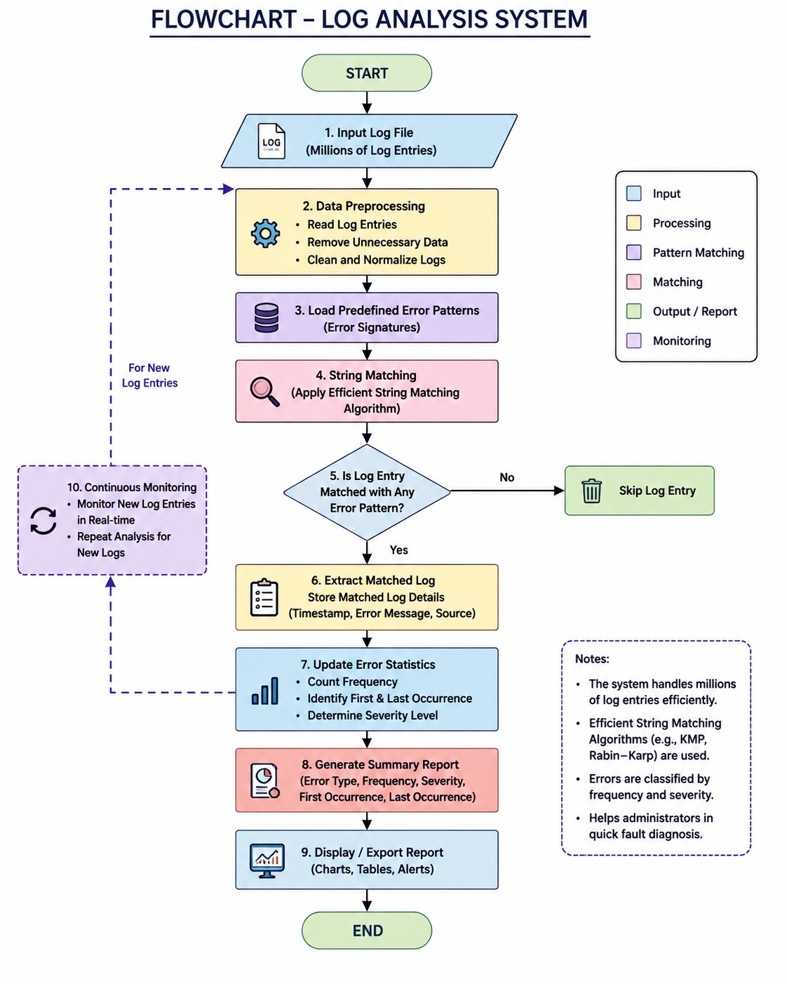

Slide 17
RESEARCHERS AND RELATED WORK
Researchers | Research / Paper | What they contributed
Shilin He, Pinjia He, Zhuangbin Chen, Tianyi Yang, Yuxin Su & Michael R. Lyu | A Survey on Automated Log Analysis for Reliability Engineering | Reviewed automated log parsing, anomaly detection, failure prediction, and diagnosis for large-scale systems.
Qiang Fu, Jian-Guang Lou, Yi Wang & Jiang Li | Execution Anomaly Detection in Distributed Systems through Unstructured Log Analysis | Proposed automatic analysis of unstructured logs and detection of execution anomalies in large distributed systems.
Shilin He, Jieming Zhu, Pinjia He & Michael R. Lyu | Experience Report: System Log Analysis for Anomaly Detection | Studied automated log analysis because manual keyword searching becomes difficult when log volume and system complexity increase.

Slide 18
Researchers | Research / Paper | What they contributed
Galip Aydin & Ibrahim Riza Hallac | Distributed Log Analysis on the Cloud Using MapReduce | Developed a distributed approach for processing large web-server logs, including frequency analysis and error detection.
Khalid Alharthi, Arshad Jhumka, Sheng Di, Franck Cappello & Edward Chuah | Sentiment Analysis based Error Detection for Large-Scale Systems | Developed an automated approach for detecting errors in large-scale/HPC system logs and identifying problematic nodes/components.
Pengfei Han, Huakang Li & Gang Xue | Distributed system anomaly detection using deep learning-based log analysis | Investigated deep-learning-based analysis of system logs for detecting anomalies in distributed systems.
Shilpika, Bethany Lusch, Eric Pershey et al. | A Scalable Pattern Mining Workflow for Interpretable Machine Log Analysis in High-Performance Computing Environments | Particularly close to your project: uses pattern mining and an Aho-Corasick finite-state automaton to identify frequent errors and fault events in massive HPC logs.

Slide 19
FEATURES
Large Log File Processing
  Handles millions of server log entries efficiently.
Predefined Error Pattern Detection
  Searches logs for predefined error signatures such as connection failures, timeouts, and authentication errors.
Efficient String Matching
  Uses algorithms such as KMP, Rabin-Karp, or Aho-Corasick for fast pattern searching.
Recurring Error Detection
  Identifies error patterns that occur repeatedly in the logs.
Frequency Analysis
  Counts the number of occurrences of each detected error.
Severity Classification
  Categorizes errors into levels such as INFO, WARNING, ERROR, and CRITICAL.
Matched Log Display
  Displays the log entries that match the predefined error patterns.
Continuous Log Monitoring
  Monitors newly generated log entries and detects errors continuously.
Summary Report Generation
  Generates reports containing error type, frequency, severity, and timestamps.

Slide 20
TECHNOLOGY STACK
Frontend: HTML + CSS + JavaScript
Backend: Python + Flask
Algorithm: Aho-Corasick / KMP
Database: SQLite
Data Processing: Pandas
Visualization: Matplotlib
Monitoring: Watchdog
Dataset: Kaggle Server Log Dataset

Slide 21
CONCLUSION
The Log Analysis System helps system administrators analyze millions of server log entries quickly and easily. It uses efficient string matching algorithms to find predefined error patterns, count their frequency, and classify them based on severity.
The system reduces manual effort and analysis time and helps administrators identify recurring and critical errors faster. Continuous log monitoring also allows new errors to be detected as they occur.

Slide 22
FUTURE SCOPE
Real-time monitoring: The system can watch logs continuously and show new errors immediately.
AI integration: AI can be used to find unusual errors automatically.
Error alerts: The system can send alerts when a serious error occurs.
Better reports: More detailed charts and reports can be added.
Cloud support: The system can analyze logs stored on cloud servers.
Failure prediction: It can predict possible system problems before they happen.
More log formats: It can support logs from different servers and applications.
Automatic problem finding: The system can help identify the main reason for an error.

Slide 23
THANK YOU

